Slide 1
Drug Review Analysis Using Elasticsearch and Kibana
By-
Monika Mishra
Under the guidance of -
Professor – Dr. Jongwook Woo

Slide 2
Introduction
Online review sites and opinion forums contain a wealth of information regarding user preferences and experiences over multiple product domains.
Web-based reviews can be viewed as an orthogonal source of information for consumers, physicians, and drug manufacturers to assess the performance of a drug.
This information can be leveraged to obtain valuable insights using data mining approaches.
Finding anomalies and predicting average rating is equally important to take corrective measures if required.

Slide 3

Platform Specification
Elasticsearch Version : 7.2.0
Number of Node: 1
Disk Size : 465.6 GB
Kibana Version : 7.2.0
Memory Size : 1.4 GB
OS : Mac OS X
Processor Speed: 3.1 GHz
Number of Processor: 1
Number of Cores: 2
Memory: 8 GB

Slide 4

Dataset Details
Dataset URL : https://archive.ics.uci.edu/ml/datasets/Drug+Review+Dataset+%28Drugs.com%29
Drugs reviewed between 2008 and 2017 obtained by crawling online pharmaceutical review sites.
File Size : 84 MB
Number of Rows : 161,297
Number of Columns : 7
File Format : TSV (Tab Separated Values)

Slide 5
Column Details
Column Name | Column Detail
id | Unique ID
drugName | Name of drug
condition | Name of condition
review | Patient review
rating | 10 star patient rating
date | Date of review entry
usefulCount | Number of users who found review useful

Slide 6
Flow Diagram
Data Acquisition
Data Preprocessing
Data Uploading
Visualizations and Insights
Anomaly Detection and Forecasting
From UCI ML Repository
Added timestamp
Mapping Changes
Used Visualize and Canvas tab on Kibana
Machine Learning

Slide 7
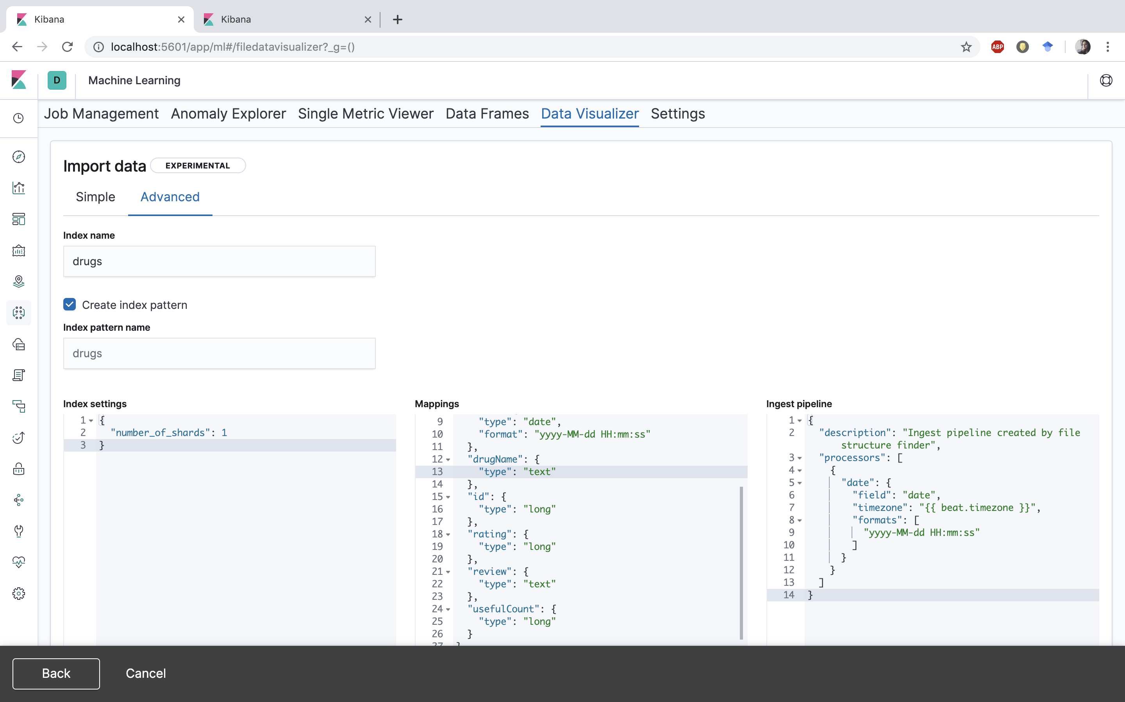
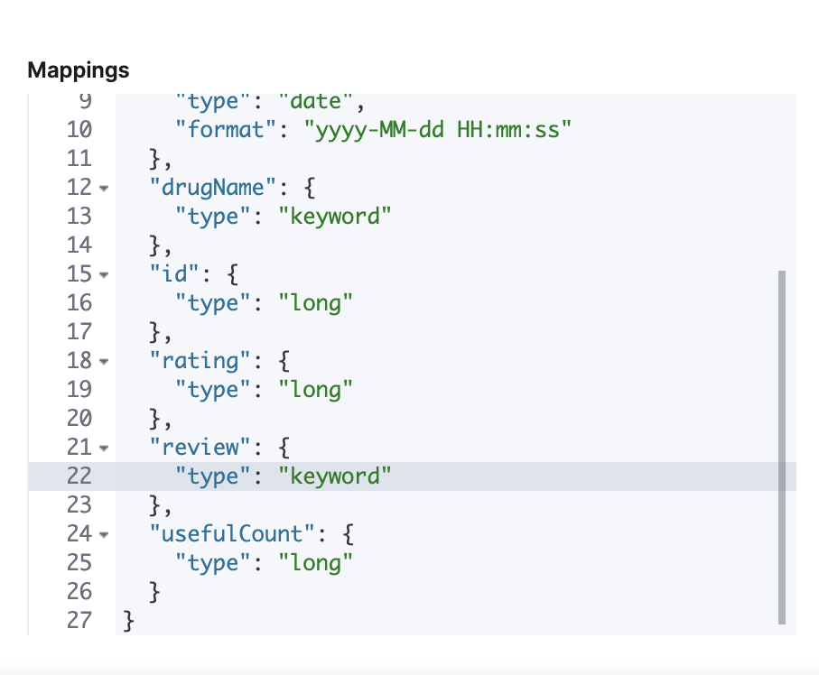
Mapping Changes
“type” of drugName and review field was changed from “text” to “keyword” so that sort or aggregation can be performed on it
Default Mapping
Change in Mapping

Slide 8
Visualizations

Slide 9
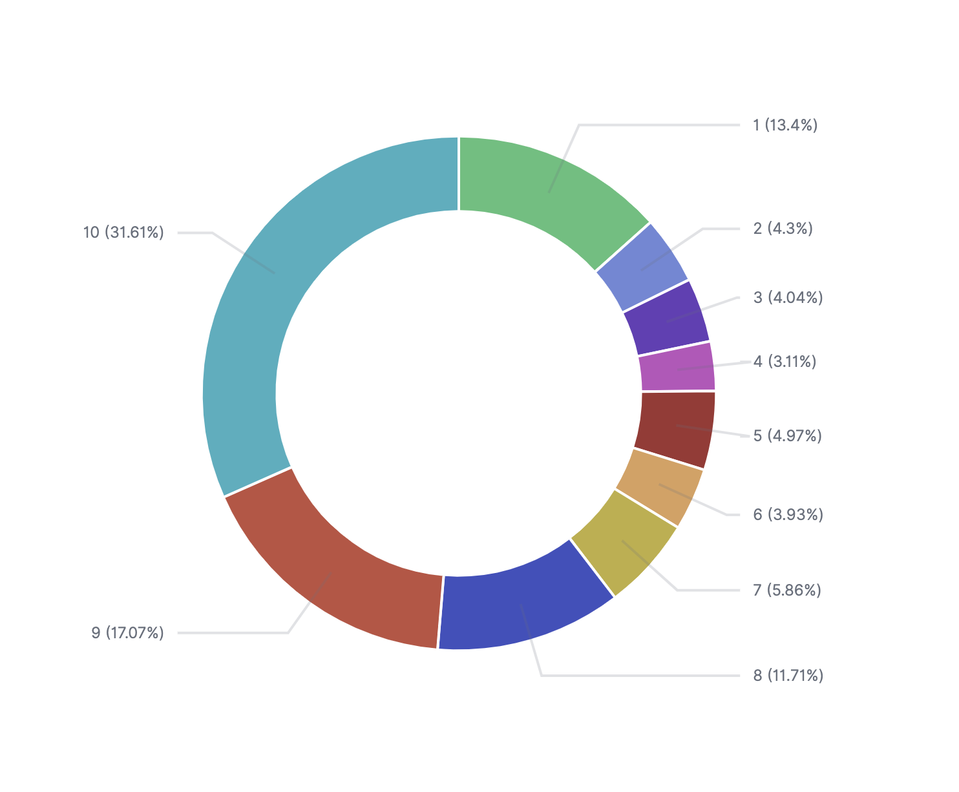
Rating Distribution

Slide 10
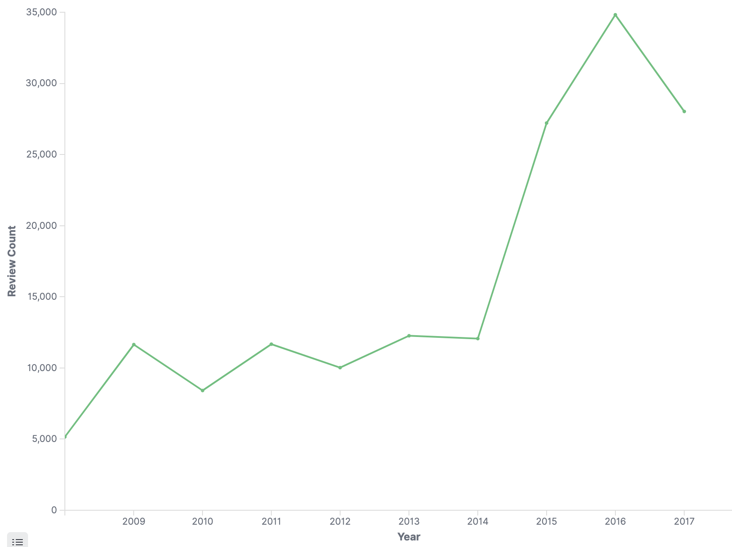
Yearly Review Count Trend

Slide 11
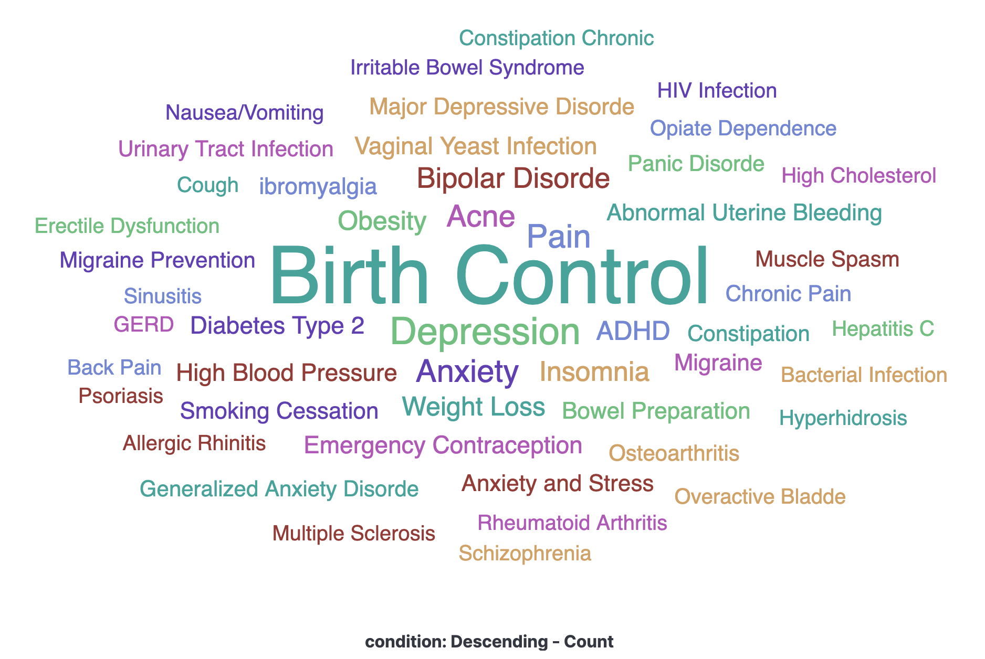
Most Common Medical Conditions

Slide 12
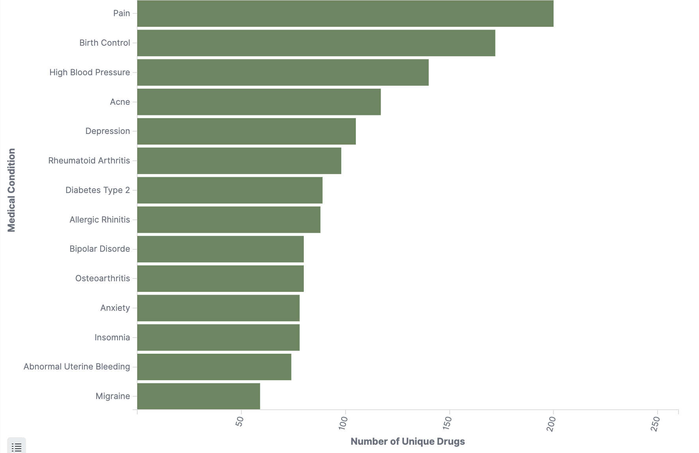
Number of Drugs Per Condition

Slide 13
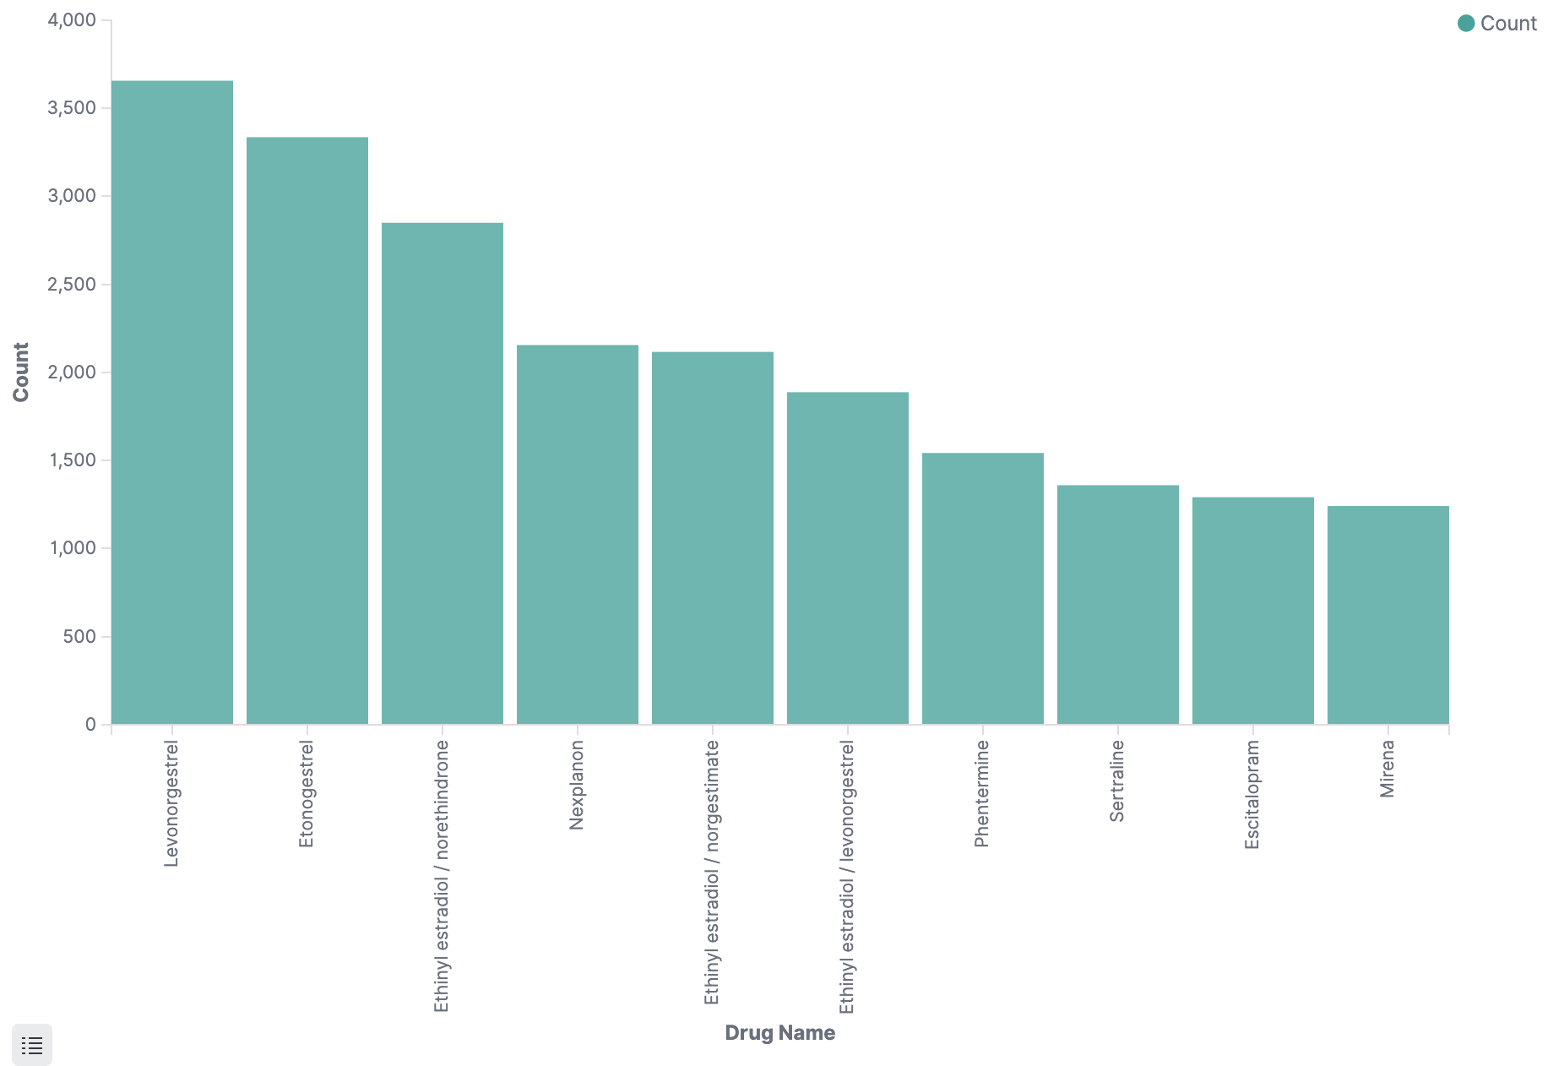
Most Reviewed Drugs

Slide 14
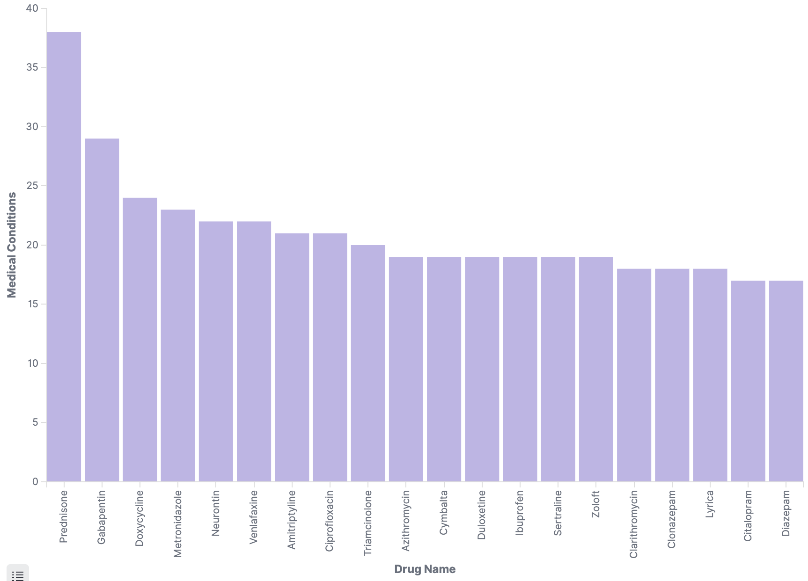
Drugs Used in Multiple Conditions

Slide 15
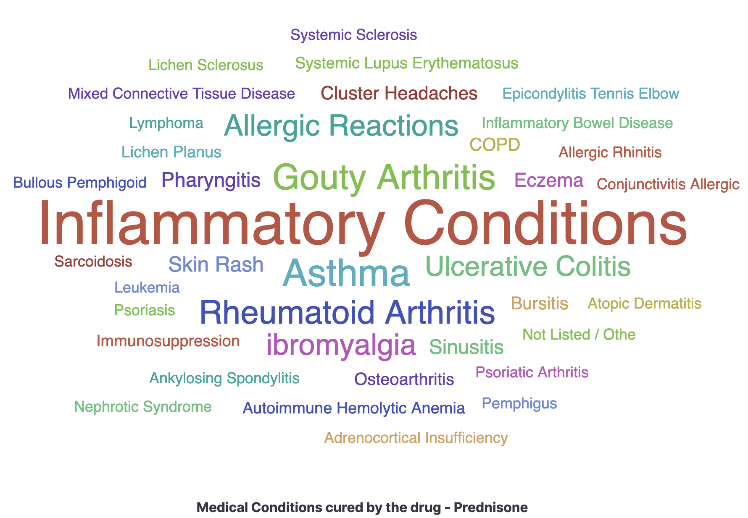
Conditions Cured By Drug - Prednisone

Slide 16
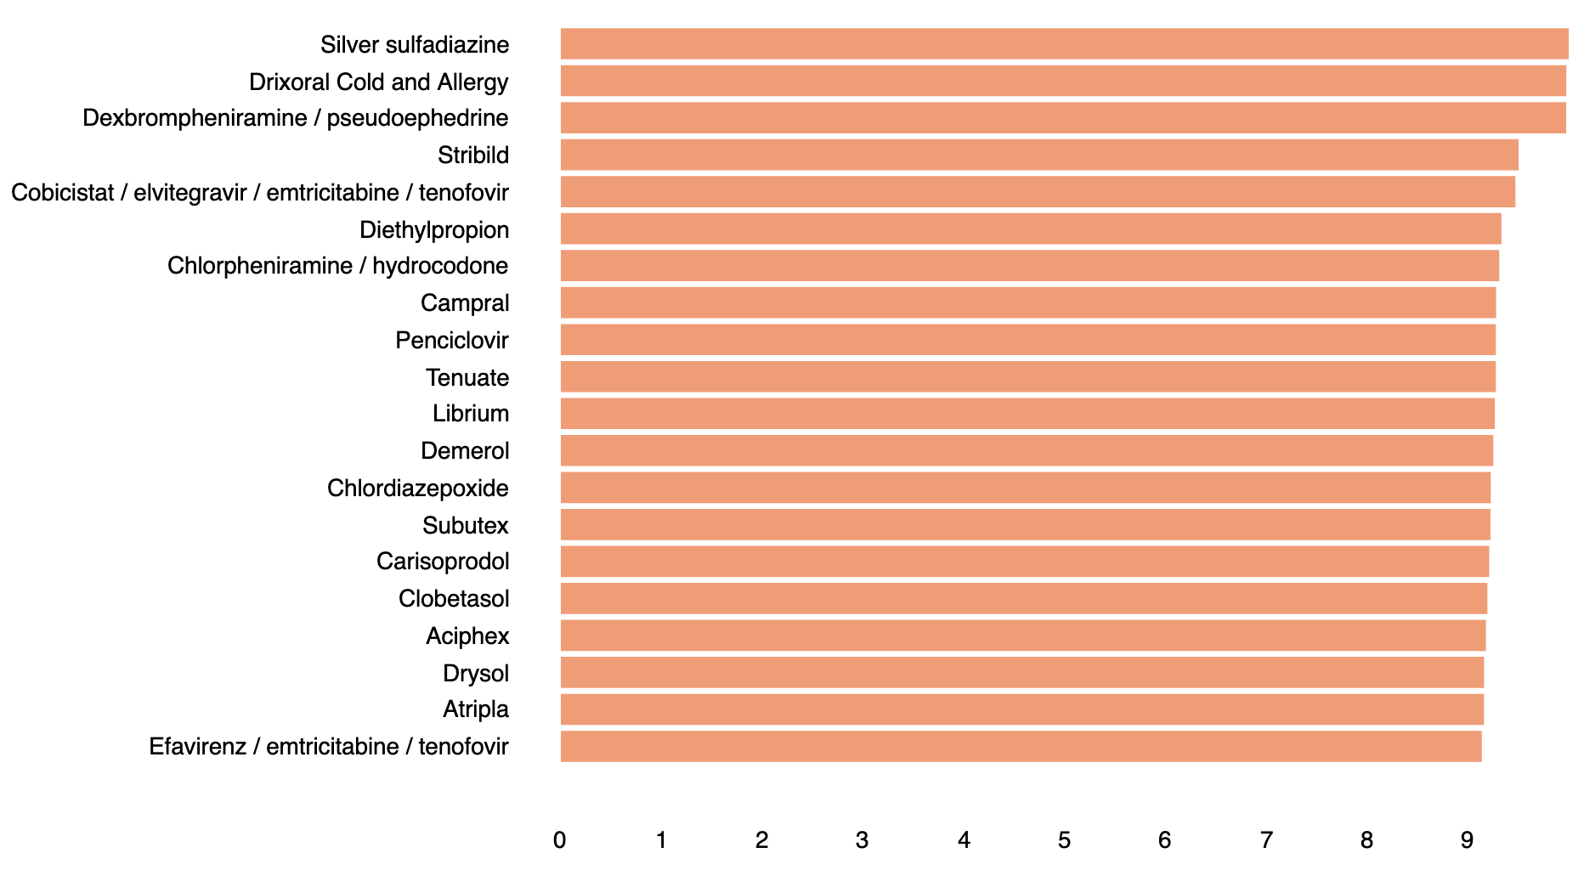
Significant Drugs With Best Rating
Based on average rating and review count > 30
select avg(rating) "rating" ,
drugName,
count(drugName) "cnt"
from drugs
group by drugName
having cnt >30
order by rating desc
limit 20

Slide 17
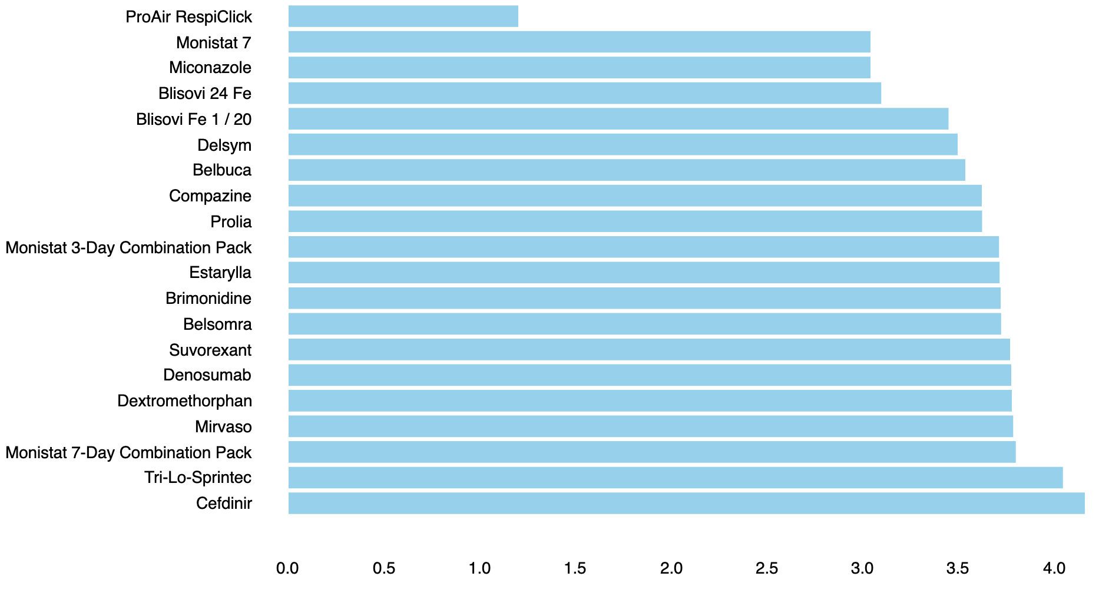
Significant Drugs With Worst Rating
Based on average rating and review count > 30
select avg(rating) "rating" ,
drugName,
count(drugName) "cnt"
from drugs
group by drugName
having cnt >30
order by rating asc
limit 20

Slide 18
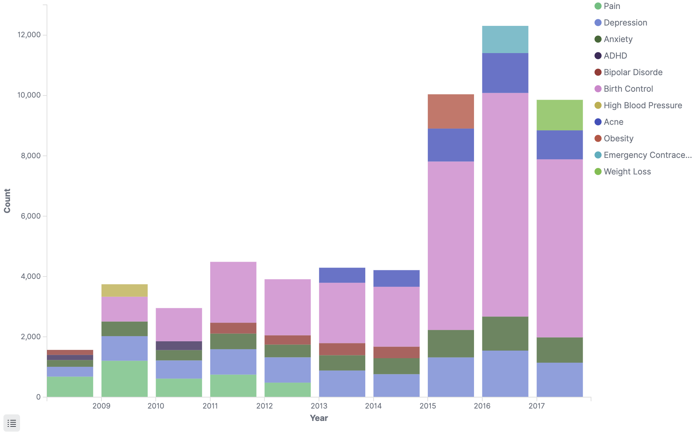
Highest Reviewed Medical Conditions
Top 5 medical conditions each year based on review count

Slide 19
Machine Learning

Slide 20
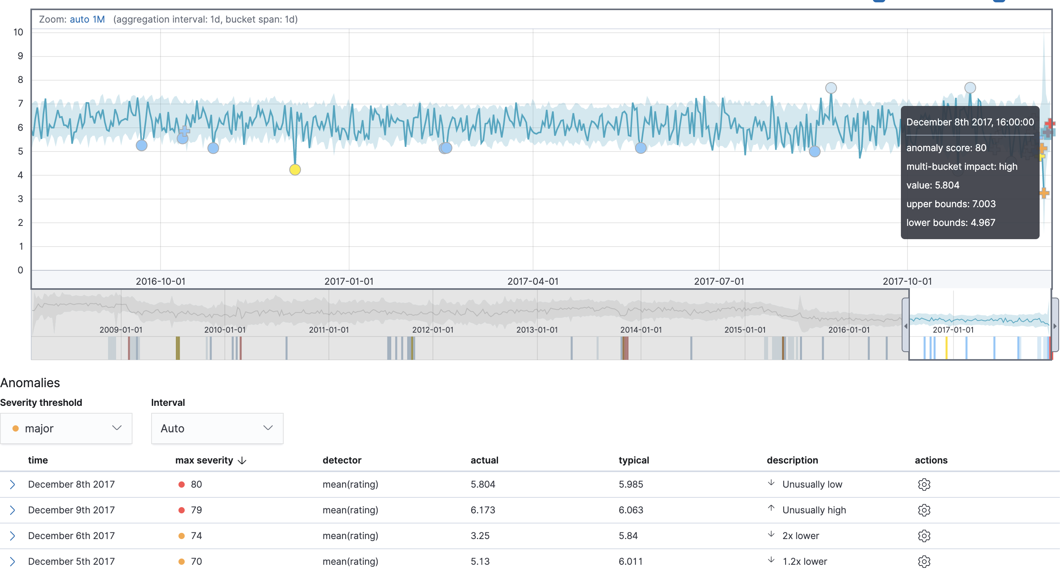
Anomaly Detection of Average Rating

Slide 21
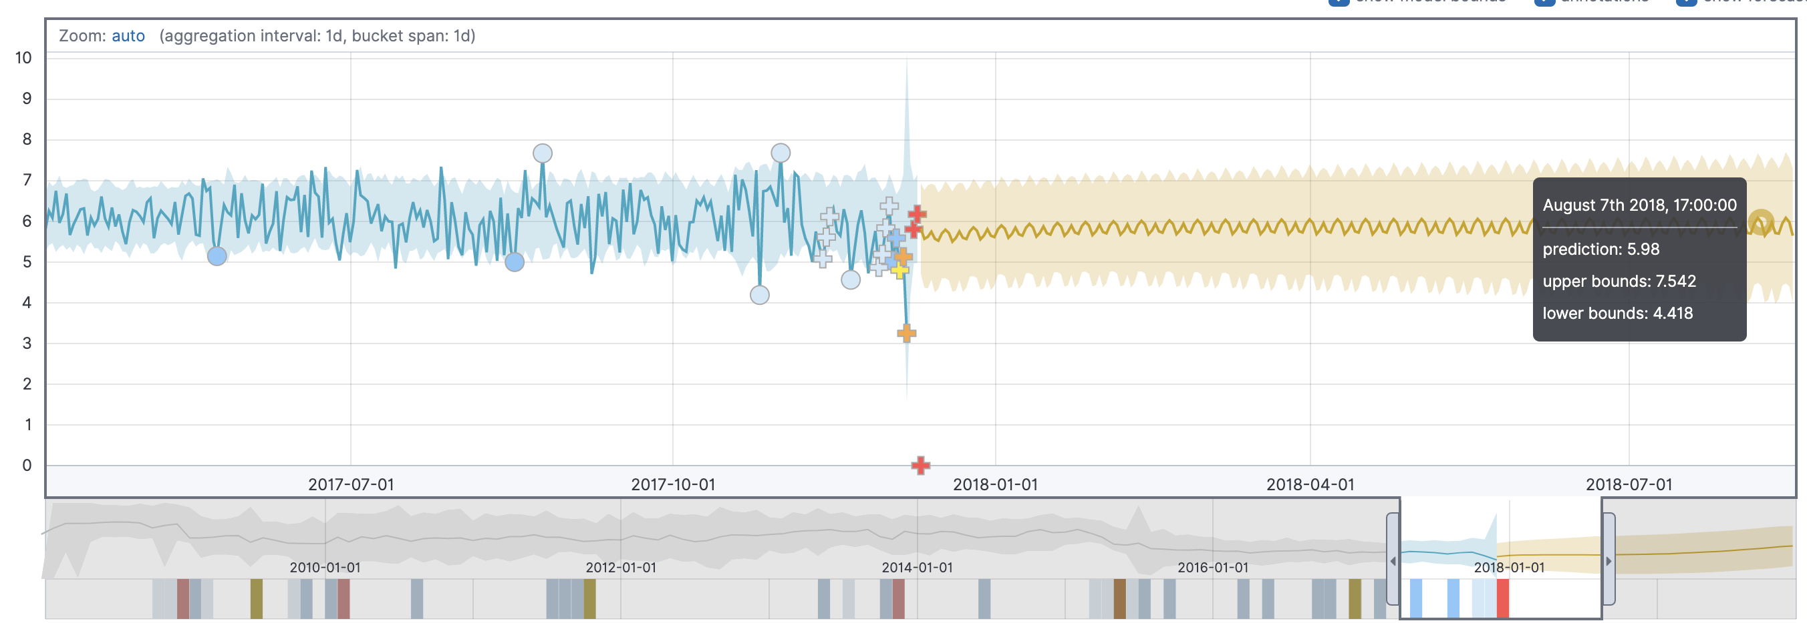
Forecasting Average Rating

Slide 22
Insights
Birth Control followed by Depression , Anxiety, and Pain are the top problems faced by the people.
Maximum drugs have been rated 10.
People’s reactions are extreme.
One drug can be used to cure multiple medical conditions.
Depression and Anxiety medical conditions comes under top 5 medical conditions in all the years being analyzed.
Review count has dramatically increased since 2015.

Slide 23
Insights
Medical conditions “Pain” has the highest number of curable medicines available.
Levonogestrel drug is the most reviewed drug.
Birth Control medical condition is pretty dominant in all the years being analyzed.
Since 2015, Birth Control condition has spiked up.
Elasticsearch and Kibana can be used for anomaly detection and forecasting.

Slide 24
Github Link
https://github.com/monika2403/mmishra2/tree/master/CIS%205900

Slide 25
References
Uysal, A. K. Comparative Performance Analysis of Techniques for Automatic Drug Review Classification. Celal Bayar Üniversitesi Fen Bilimleri Dergisi, 14(4), 485-490.
Bhargava, A. (2019). Grouping of Medicinal Drugs Used for Similar Symptoms by Mining Clusters from Drug Benefits Reviews. Proceedings of International Conference on Sustainable Computing in Science, Technology and Management (SUSCOM), Amity University Rajasthan, Jaipur - India, February 26-28, 2019
Gräßer, F., Kallumadi, S., Malberg, H., & Zaunseder, S. (2018, April). Aspect-based sentiment analysis of drug reviews applying cross-domain and cross-data learning. In Proceedings of the 2018 International Conference on Digital Health (pp. 121-125). ACM

Slide 26
Thank You

